Slide 1

DataFest 2023
Team </Blank>

Slide 2
Introduction
Clients using ABA’s service often have urgent problems and limited access to other resources.
Research Question:
How is response time in ABA services affected by different variables and related to the outcomes and satisfaction of clients?

Slide 3
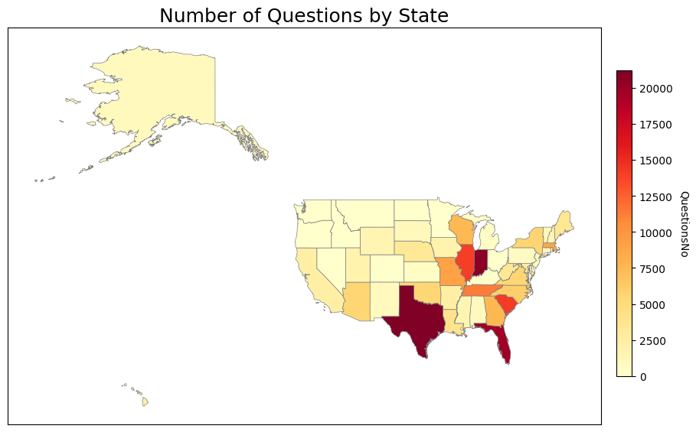
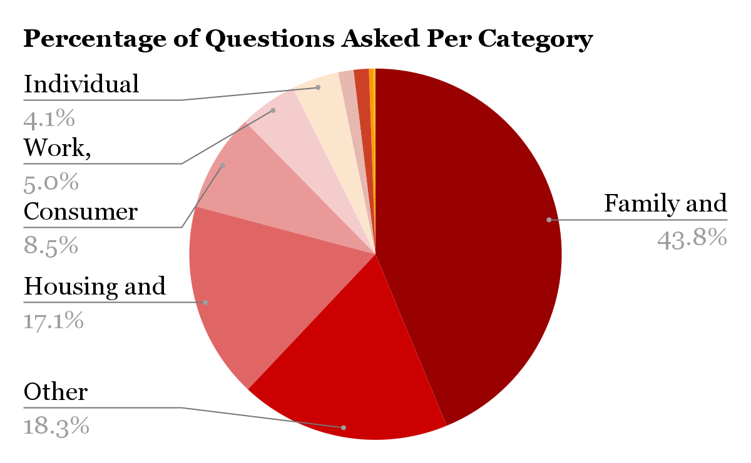
Exploratory Data Analysis

Slide 4
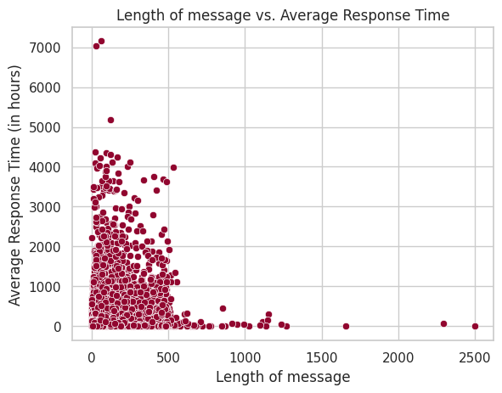
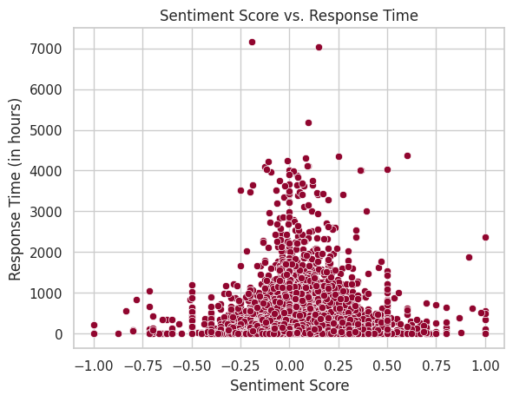
Focusing on Response Time

Slide 5
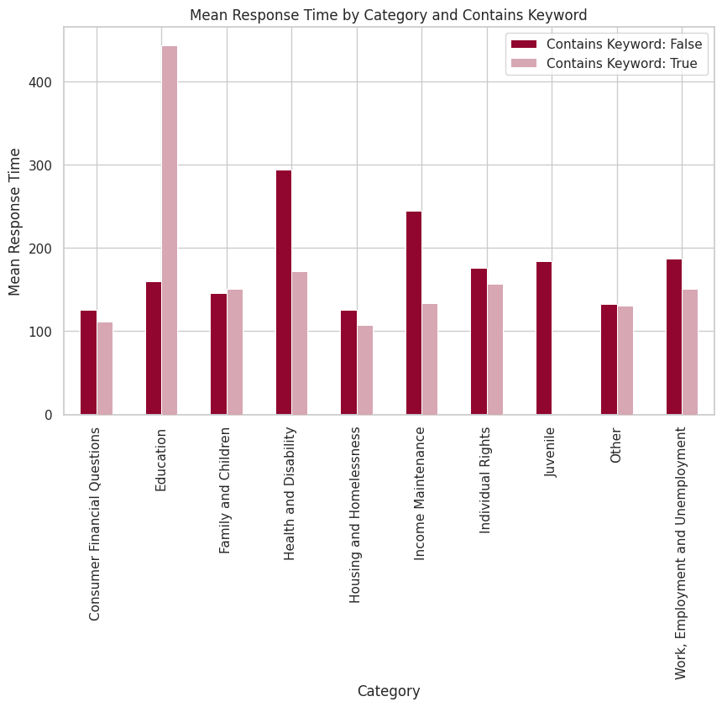
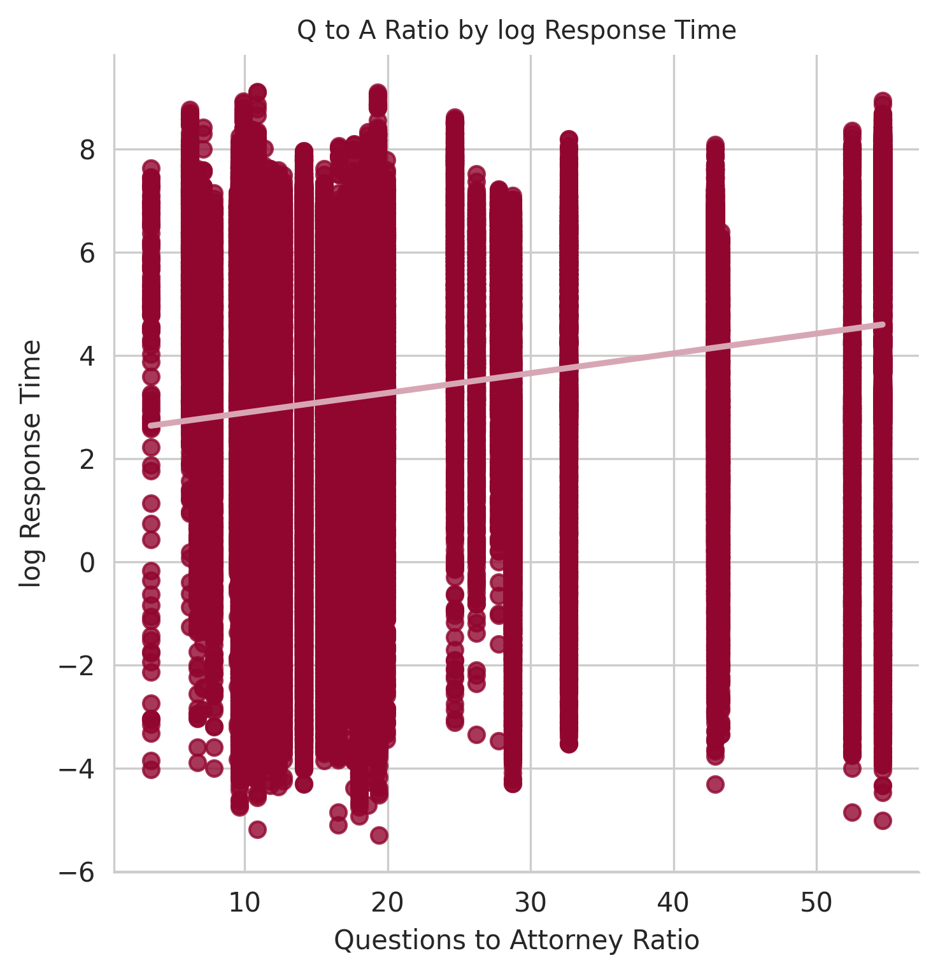
Notes:
The F-statistic is reported as 5473, with a probability (p-value) of 6.129*10^-6, indicating that the model as a whole is statistically significant.
However, the adjusted R-squared is also reported as 0.036, indicating that only a small proportion of the variance in logResponseTime is explained by the model.
The coefficients also shows a significant positive effect on logResponseTime

Slide 6
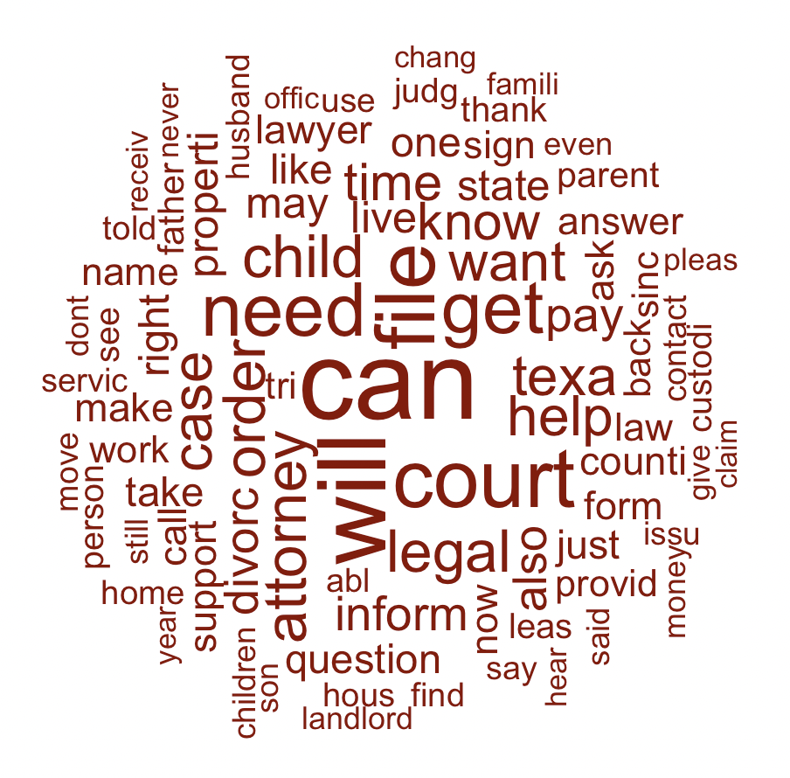
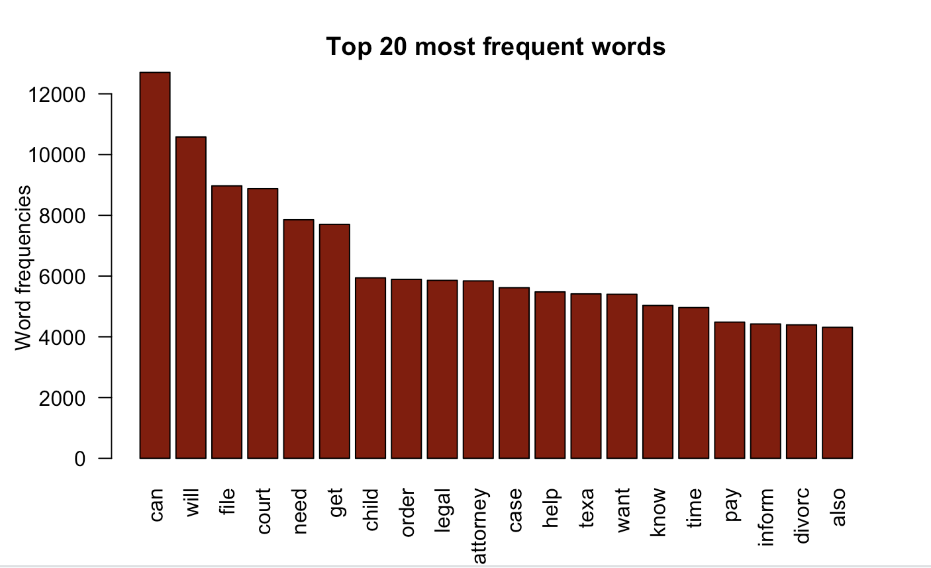
Language analysis
We analyzed the language of the question posts in the state of Texas in order to figure out the most frequently used words in these posts
Word cloud of some of the most frequent words in the question posts in Texas
Because the state of Texas was one of the states with the most questions asked, we decided to focus on this state for the rest of our analysis.
.
Top 20 most frequent words in the question posts in Texas

Slide 7
Working towards a regression model using sentiment analysis
Extracted first and last messages for Texas from question_posts dataset
Created datasets for first and last messages
Assigned sentiment scores using a keyword model (-1 to +1)
Negative score messages extracted from last message dataset
Datasets divided into good/ bad sentiment based on score
Sentiment score = sum of keyword scores in message
Used negative score dataset to build regression model

Slide 8
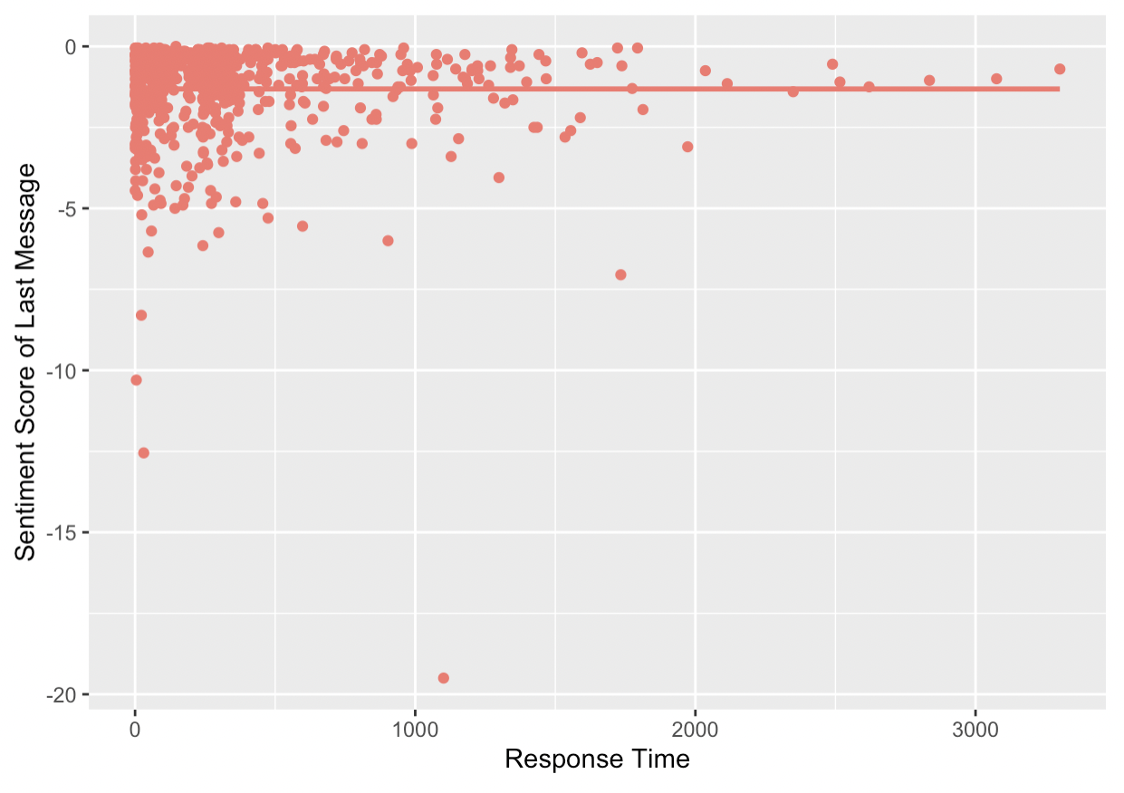
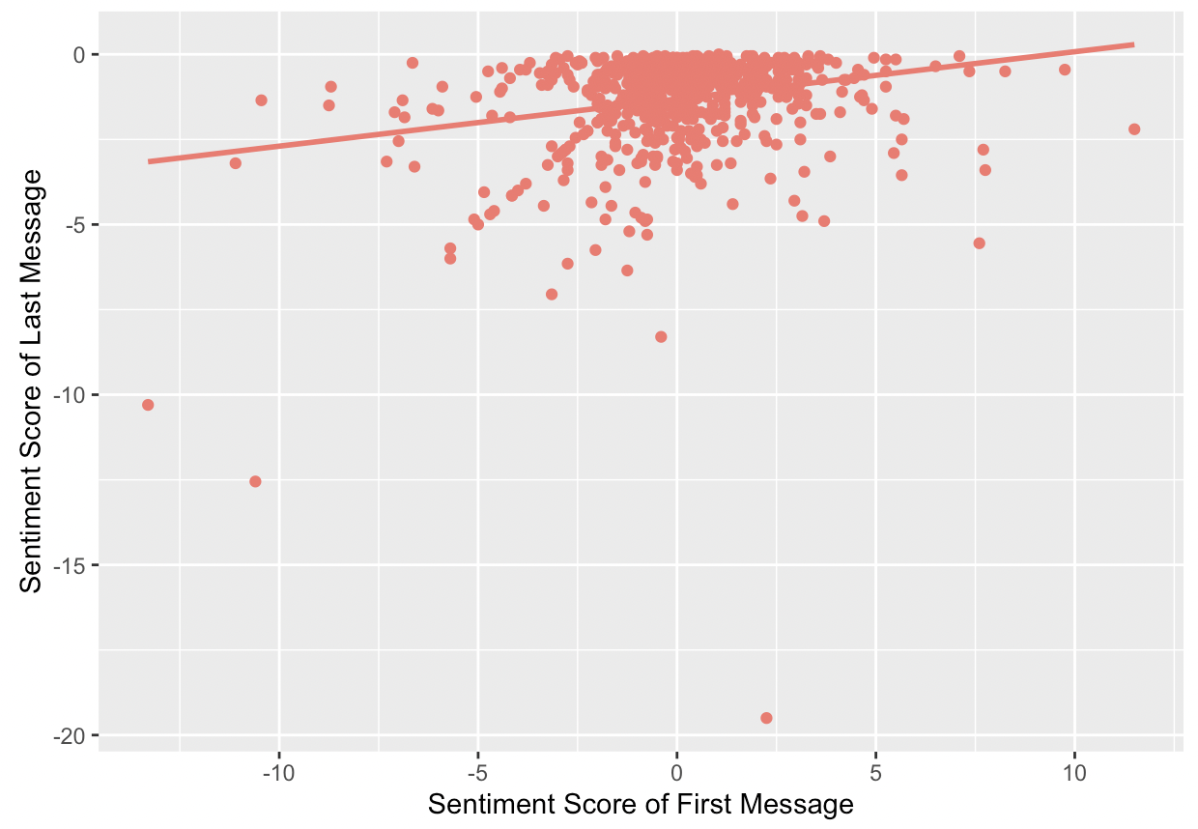
Model Development
Multiple Linear Regression model:
sentimentLastMessage = -1.305 - 1.458*10⁻⁵ responseTime
+ 0.1388 sentimentFirstMessage
Null hypothesis: The response time and the sentiment score in the first message in a conversation has no relationship with the sentiment score in the last message in the conversation.
Alternative hypothesis: The response time and the sentiment score in the first message in a conversation has a relationship with the sentiment score in the last message in the conversation.
ɑ = 0.05, p-value = 5.392*10⁻⁹
Because our p-value is below our ɑ level, we reject the null hypothesis and conclude that response time and sentiment in the first message have a relationship with the sentiment score in the last message.

Slide 9
Conclusions
Longer response times lead to more negative sentiments in the final message
Have the system prioritize messages that were posted earlier
Lower sentiment scores in the first message relate to lower sentiment scores in the last message
Ensure that the attorneys’ first messages in a conversation have positive sentiments
Also consider visualization findings
Focusing recruiting efforts to states with higher question volume to attorney ratio
Encourage clients to write a detailed description of the issue

Slide 10
Further study
When we built our regression model, we were limited by the memory of our machines and the time we had to conclude the study.
Further studies might focus on applying the language analysis to the data from the other states too, and developing a regression model that can be applied to all the states.

Slide 11
References
https://www.red-gate.com/simple-talk/databases/sql-server/bi-sql-server/text-mining-and-sentiment-analysis-with-r/
https://www.r-bloggers.com/2021/05/sentiment-analysis-in-r-3/

